Slide 1
Stocks and Fundamental Data
Predicting if a stock will go up 5% or more in the next quarter

Slide 2
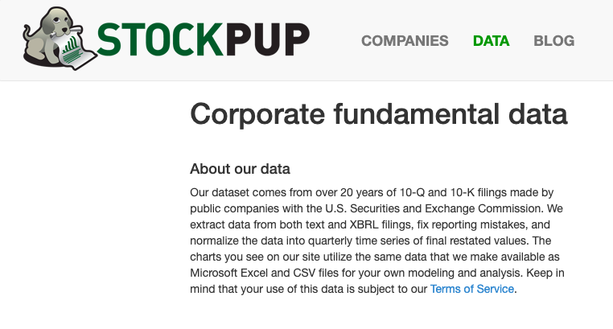
The Data

Slide 3
The Data
756 Stocks with respective fundamental data
Cleaned Data:
Filled NaNs with Backfill, then removed any further NaNs
Left with <2,000 rows

Slide 4
Altering the Data
(Feature Engineering)
New columns derived from original features:
Values were percent improvement from past quarter to current quarter.
Classification column (True or False):
True if future quarter price increased > 5% compared to current quarter
False if otherwise
Balanced the Classes:
Removed any excess classes of True or False

Slide 5
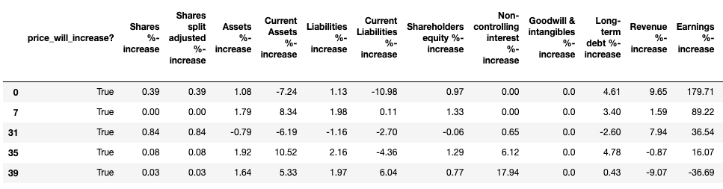
The Final DataSet Preview

Slide 6
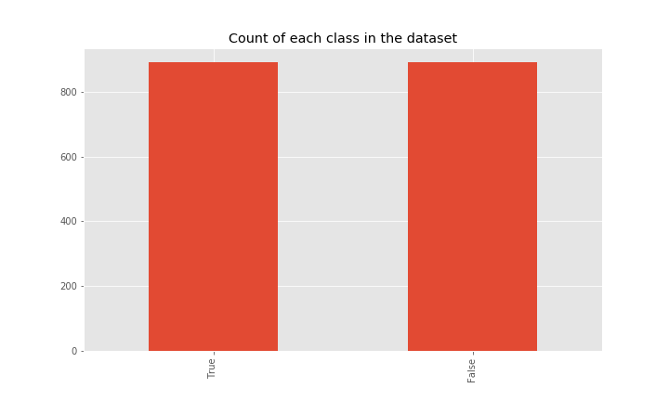
Class Balance

Slide 7
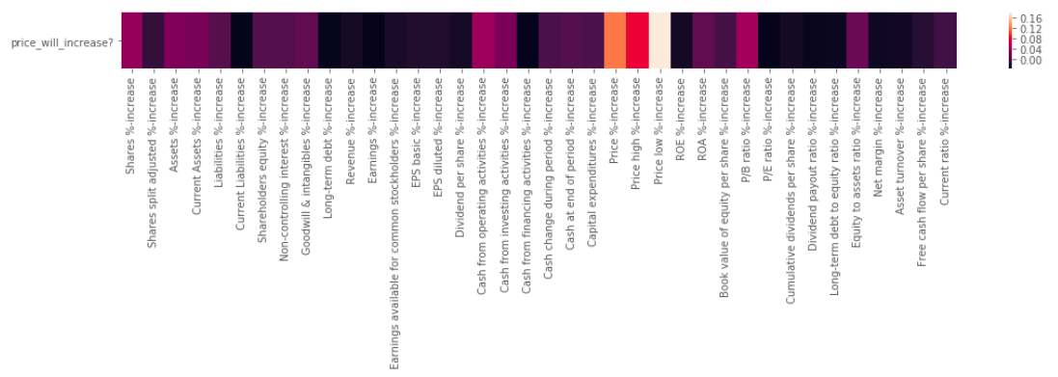
Features Correlation

Slide 8
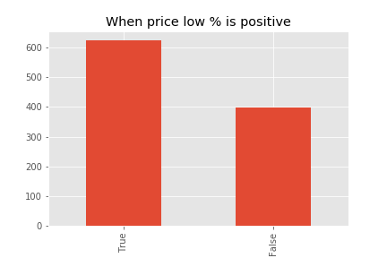
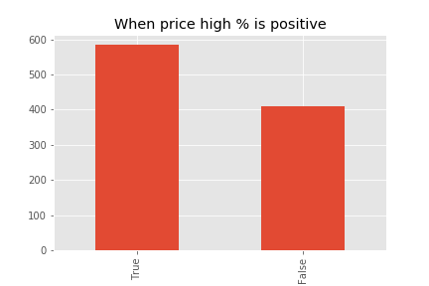


Count of True/False when specific features are positive

Slide 9
Modeling

Slide 10
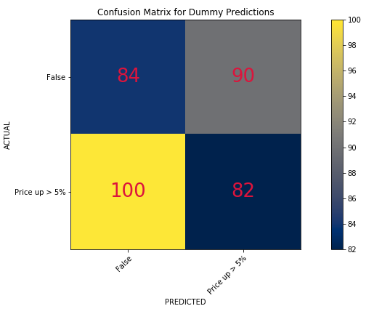
Baseline Model:
Dummy Classifier
Accuracy:
46%
F1 Score:
46%

Slide 11
Models Used
Optimized using GridSearchCV
Logistic Regression
K Nearest Neighbors
Decision Tree
Random Forest
XGBoost

Slide 12
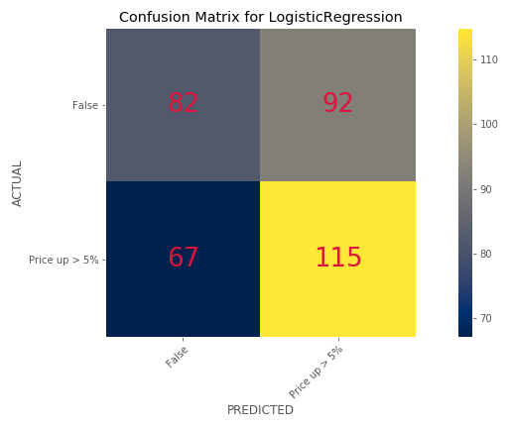
Logistic Regression
Accuracy:
56%
F1 Score:
60%

Slide 13
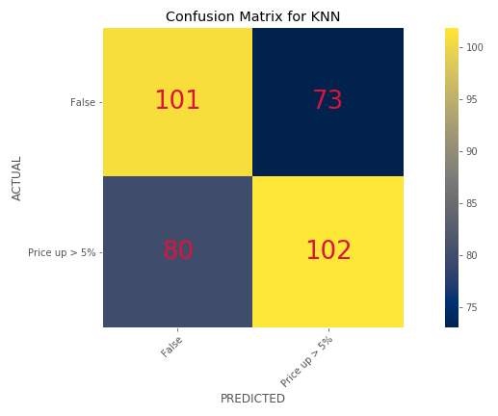
K Nearest Neighbors
Accuracy:
57%
F1 Score:
57%

Slide 14
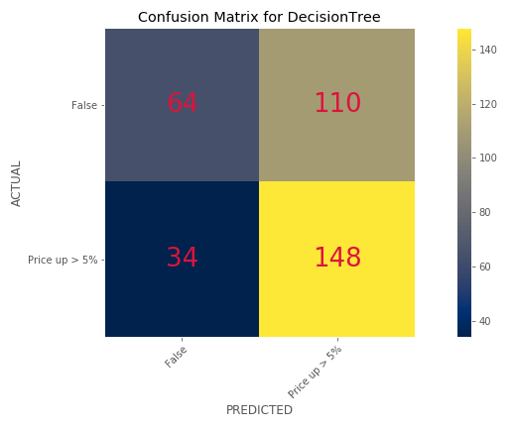
Decision Tree
Accuracy:
59%
F1 Score:
67%

Slide 15
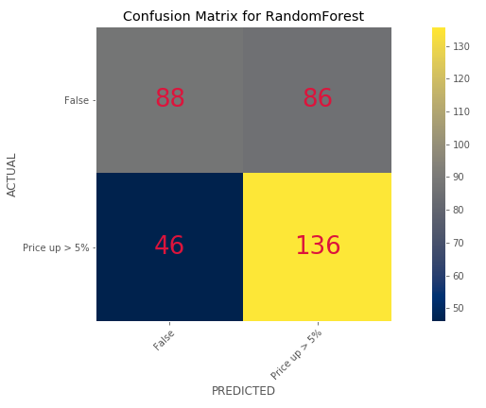
Random Forest
Accuracy:
58%-62%
F1 Score:
62%-67%

Slide 16
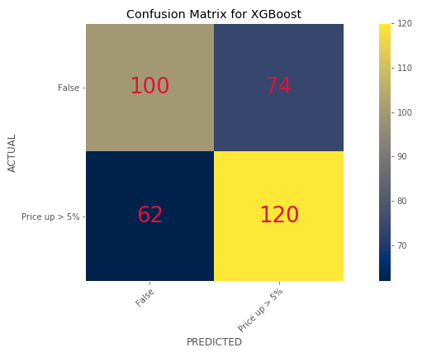
XGBoost
Accuracy:
61%
F1 Score:
63%

Slide 17
Best Model
For the Risk-Averse:
XGBoost
Most consistent
For the Risk-Takers:
Random Forest
More opportunities

Slide 18
Which Features were important?

Slide 19
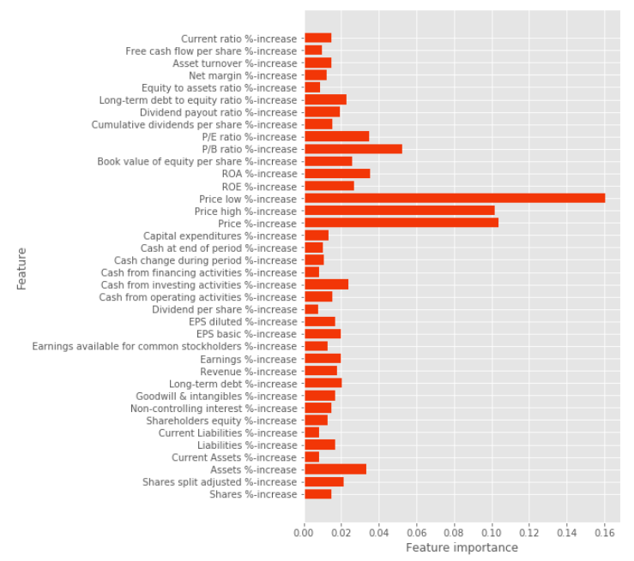
Random Forest
Price Low
Price High
Price
Emphasis on Price Low

Slide 20
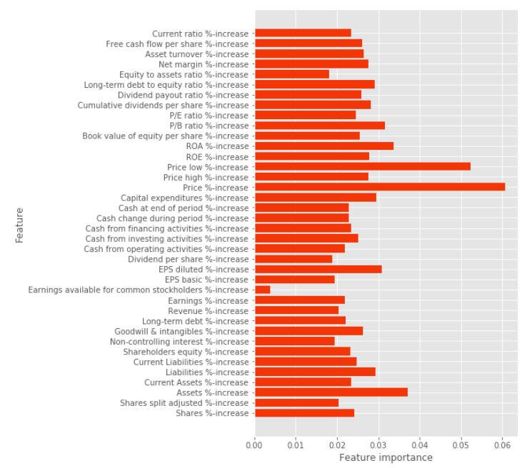
XGBoost
Price Low
Price
Both are almost equally important

Slide 21
Potential Improvements
Add feature interactions
Eliminate unimportant features
Look for other sources
Potentially run more models (SVM, Naive Bayes).

Slide 22
Summary
Best models:
XGBoost
Random Forest
Depending on your risk tolerance
Look for Price High/Low changes

